Slide 1


OSCode
DECODE SIH 2026
by communityX
TRAFFIXAI
AI-Powered Smart City Traffic Digital Twin with Emergency Response and Congestion Intelligence
PRESENTED BY:
CipherSquad (Code: KE5VND)Adamas University, Kolkata| SIH 2026 Bharat Nirman PS1

Slide 2
OSCode
TEAM MEMBERS
by communityX
Deep Shekhar Halder (Team Leader) Sayan Pramanik
Soumyojit Banerjee Suman Mondal
Kausturi Chakraborty Rituraj SahaL

Slide 3
OSCode
PROBLEM STATEMENT
by communityX
Problem Title: AI Traffic Digital Twin for Smart Traffic Optimization and Congestion Prediction
What does this Problem Aim to Solve?
The core problem:
• Urban traffic congestion drives massive economic losses, increased carbon emissions, and severely slower emergency response times in Indian cities.
• Current traffic signal controllers rely on fixed timers or manual intervention, completely blind to real-time lane-level
density and vehicle priority.
Problem it aims to solve:
• Transition traffic networks from static timing to fully adaptive, real-time decision-making.
• Fuse AI vision, radar, and V2X telemetry into a live 3D digital twin to predict congestion and prioritize emergency vehicles automatically.
Why did your team choose this?
• We already developed and optimized an edge traffic AI core that transforms video streams into live spatial coordinate systems.
• This existing 2D digital twin foundation allowed us to accelerate development and focus on a real-world deployable platform.

Slide 4
OSCode
REAL-WORLD PROBLEM ALIGNMENT
by communityX
Who faces this issue?
Daily Commuters: Endure long travel delays and fuel wastage.
Emergency Services: Ambulances and fire engines delayed by static gridlocks.
Smart-City Authorities: Lack analytics and tools for active management.
Connected & Autonomous Vehicles (CAVs): Require real-time signal phase and timing (SPaT) data.
What’s the current gap in the system?
Fixed-time signal cycles fail to adapt to live traffic density.
No lane-level spatial awareness or emergency vehicle preemption.
Lack of multi-sensor fusion (vision and radar) to handle poor weather or low-visibility conditions.
How does your proposed solution fill that gap practically?
Live 3D Digital Twin model built by fusing YOLOv26n vision, Doppler radar, and V2X telemetry.
Reinforcement learning (PyTorch DQN) dynamically adapts signals.
SUMO micro-simulation validates policies in real time before deployment on hardware controllers.
If possible, mention if it connects to any existing schemes. (E.G., Skill India, Digital India, etc.)
Smart Cities Mission: Directly provides intelligent transportation and traffic optimization.
Digital India: Deploys state-of-the-art AI core and models directly on resource-constrained edge hardware.
National Automotive Board V2X Connected Vehicle Initiative: Implements C-V2X 5G GLOSA speed advisories.

Slide 5
OSCode
PROPOSED SOLUTION
by communityX
What are you Building?
TraffixAI is an AI-powered Smart City Traffic Digital Twin that fuses YOLOv26n computer vision, 24GHz Doppler radar, and C‑V2X telemetry into a live 3D traffic model. Reinforcement learning dynamically optimizes traffic signals while simulation validates decisions before deployment. The platform also supports emergency vehicle prioritization, ANPR e‑challans, congestion forecasting, and carbon-emission tracking.
What are the 3-4 Key Features?
Digital Twin + BEV Tracking: Generates a 3D homography bird's-eye-view of intersections with live per-lane reticle tracking.
DQN + SURTRAC Optimization: PyTorch reinforcement learning combined with SURTRAC earliest-deadline-first arrival scheduling.
Emergency Vehicle Priority: Acoustic siren preemption and C-V2X direct signals grant green clearance instantly.
Congestion Forecasting and ANPR: XGBoost multi-horizon volume prediction (+15m / +30m / +60m) and license-plate OCR.
What makes it different or innovative?
Combines camera vision, 24GHz radar fusion, C-V2X direct vehicle comms, Deep-Q signal optimization, and parallel micro-simulation validation into a single, cohesive thread-safe platform deployed directly on edge-nodes.

Slide 6
OSCode
TECH STACK & ARCHITECTURE
by communityX
Tech Stack
• Frontend command center: Next.js and React Dashboard.
• Backend core service: Python 3.14 + Flask REST/WebSockets.
• Computer Vision & ML: YOLOv26n, PyTorch, XGBoost.
• Telemetry & Hardware: C-V2X 5G, SQLite logging, Arduino, Raspberry Pi.
APIs/Libraries
• Vision/ML: cv2, numpy, ultralytics (YOLO), torch, xgboost, sklearn.
• Backend/Communications: flask, pyttsx3, serial, RPi.GPIO.
• Display/Indicators: luma.oled, luma.led_matrix, winsound.
Deployment Plan
• Edge Node: Containerized Docker running on NVIDIA Jetson Orin Nano or Raspberry Pi 5.
• Hardware Interfaces: Arduino Uno relay traffic controllers + OLED screen + MAX7219 VMS LED matrix.
• Cloud: Command-center React dashboard hosting the map view & database logs.
High-level Block Diagram OR Architecture
•SENSE: Camera & radar streams are processed in real time.
•TWIN: YOLOv26n + bird's-eye BEV homography creates 3D intersection.
• OPTIMIZE: PyTorch DQN + SURTRAC scheduler evaluates signal phase.
• ACT: Candidate policies validated in a 9-scenario SUMO grid then sent to Arduino controllers.

Slide 7
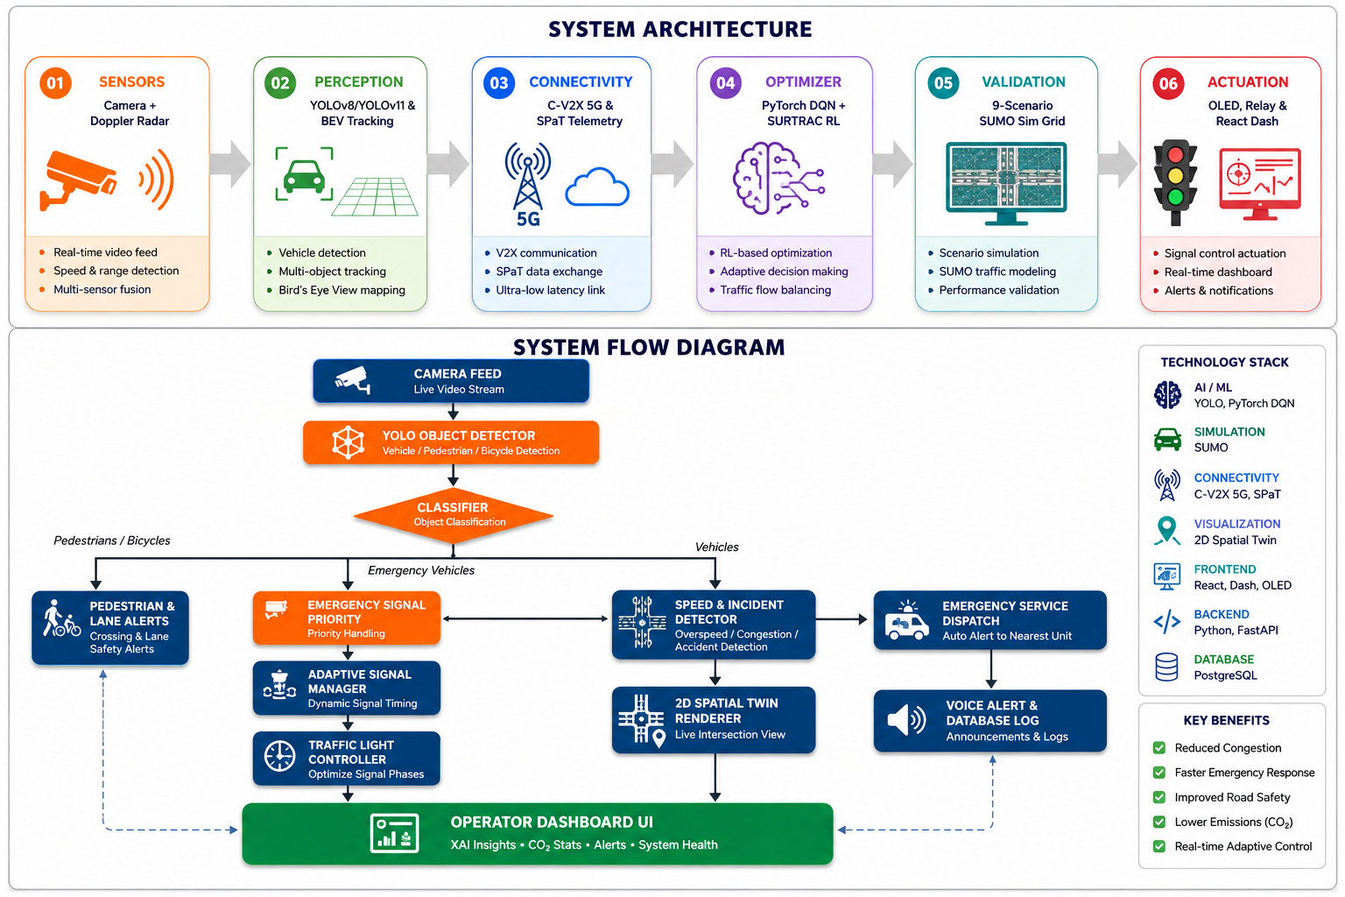
OSCode
ARCHITECTURE DIAGRAM
by communityX
Show the Technical Flow using a simple block diagram.
See the interactive technical flowchart rendered on the right side of this slide.
Mention Frontend/Backend/Tools/API connections.
• Frontend: React & MapLibre 3D GIS • Backend & Core: Python 3.14 + Flask • API: Groq
Include Cloud/Database/ML Model (if applicable)
• ML Model: PyTorch, Scikit Learn, XGBoost, YOLOv26n • DB: Structured SQLite on edge, synced to central cloud.

Slide 8
OSCode
Conclusion
by communityX
From Research Gaps to a Deployable Digital Twin
TraffixAI unifies vision, radar, V2X connectivity, reinforcement-learning signal control, and simulation-validated deployment into a single thread-safe edge system — directly aligned with the Smart Cities Mission, Digital India, and V2X connected-vehicle initiatives.
Future Work Roadmap
• Multi-intersection network-wide coordination
• Federated learning across city-wide edge nodes
• Pilot deployment with a municipal traffic authority

Slide 9
OSCode
by communityX
THANK YOU

